Slide 1
The Layered Use of Film in Criminal Justice Studies
David D. Balkum, M.A.T.S., M.C.J., J.D.
Concordia University Texas
May 17, 2017

Slide 2
Why Film?

Slide 3
Why Film?
It teaches through other voices (especially not mine).

Slide 4
Why Film?
It captures students’ attention
(and competes with technology).

Slide 5
Why Film?
It presents a sophisticated and well-done message (if I’ve done a good job picking the film).

Slide 6
Why Film?
It reinforces other messages
(that I’ve already introduced).

Slide 7
Who said that?

Slide 8
Who said that?
“[C]ritical studies of film & media reveal significant insight to prevailing social power structures, modes of communication and persuasion, and forms of entertainment.”
https://www.depts.ttu.edu/english/grad_degrees/FMStudies_default.php

Slide 9
Who said that?
“Crime films are one of the world’s most effective means of debating issues of crime and justice. . . . [T]hey invite us to participate in global examinations of social problems while keeping us entertained. /

Slide 10
Who said that?
Crime films, in truth, are not a problem but a response to problems, a way of posing questions and evaluating solutions.”
Shots in the Mirror: Crime Films and Society (2nd ed.). Nicole Rafter. Oxford University Press. 2006.

Slide 11
Who said that?
“[S]tudents have few ways to connect the criminological theories they study with actual criminal behavior; they simply cannot visualize the theories inaction. When we asked students if /

Slide 12
Who said that?
keying each theory to a specific movie would help, they responded with something close to joy. . . . Movies could bring the theories to life.”
Criminology Goes to the Movies. Nicole Rafter and Michelle Brown. New York University Press. 2011.

Slide 13
Who said that?
“A film provides a virtual experience, an enveloping story in which the viewer identifies with characters and is emotionally drawn into the protagonist’s dilemma.”
“White Collar Crime Goes to the Movies.” Geraldine Szott Moohr.
Ohio State Journal of Criminal Law. Vol. 11:2. 2014.

Slide 14
Who said that?
“The point is . . . the awakening . . . of teacher awareness of the helpfulness of popular film in the classroom. Cinema is about imagination and creativity. [T]he success of a cinema-based /

Slide 15
Who said that?
course greatly depends on the educator’s class management skills and the ability of the educator to open students’ minds. Many students have spent their lives watching movies /

Slide 16
Who said that?
predominantly for their entertainment value. While not displacing its entertainment value, cinema in the classroom requires students to act both as academic and critical consumers /

Slide 17
Who said that?
of popular culture. Educators thus face the challenge of teaching students how to examine movies in ways that may seem foreign, if not awkward.”
“The Selective Use of Cinema in Criminal Justice Education.” Ryan Turner and David Perkins. Journal of Criminal Justice and Popular Culture. Vol. 15(3). 2008.

Slide 18
Layering

Slide 19
Layering
Students usually are excited about a film. It will be fun, give them a break from taking notes, not tax their brains, shut me up, have lots of explosions and blood, and / or (maybe) be interesting.

Slide 20
Layering
I’m fairly traditional in that I usually won’t introduce a film until we’ve covered some solid, applicable academic theory. Read the text, listen to lecture, call on students for answers, worksheets. Standard stuff.

Slide 21
Layering
But, they know that a film is coming. They also know that there’s much more to it than just watching it.

Slide 22
Layering
I start out by assigning them to complete a form while watching the movie. The fun quotient starts dropping.

Slide 23
Layering
I

Slide 25
Layering
We then watch the movie. Longer class sessions mean that we can do more in a block of time, but work with what you have.

Slide 26
Layering
After watching the film (or a segment), we break for discussion. My layering concept means that we have some structure (and popcorn),but I let the class atmosphere and dynamics take the lead on the discussion.

Slide 27
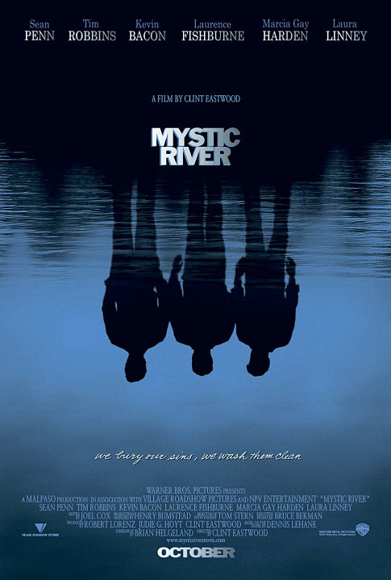

Slide 29
Layering
Let’s watch the Mystic River trailer just to pick up on some themes.
https://www.youtube.com/watch?v=6kiCrW4W2So

Slide 30
Layering
Discussion takes over the class when students are into the film. Arguments, opposing viewpoints, et cetera. If the movie is well-chosen and well-done, then it opens doors for students exploring different perspectives.

Slide 31
Layering
If I’m lucky, then I can integrate some journal articles or movie reviews into our discussion. These hopefully will take our discussion in new directions and generate different and deeper persepctives.

Slide 32
Layering
In the case of Mystic River, I assign three journal articles for reading.

Slide 36
Layering
After students have watched the film, taken notes about the film, discussed the film, integrated learning from the text, and read the journal articles, then the fun starts.

Slide 37
Layering
For better or worse, I use the word layering to describe the process. The final layer consists of a worksheet.

Slide 38
Layering
My worksheets consist of a variety of objective and subjective items that cover Bloom’s taxonomy from top to bottom. Here are some sample questions from Mystic River worksheet.

Slide 42
Layering
I hear a lot about how difficult the worksheets can be. However, I just received this assessment from a struggling white collar crime student a few days ago at the end of that course.

Slide 43
Layering
“Movies were a great Tool to help visualize the points and put it in a more understandable aspect.”

