Slide 1
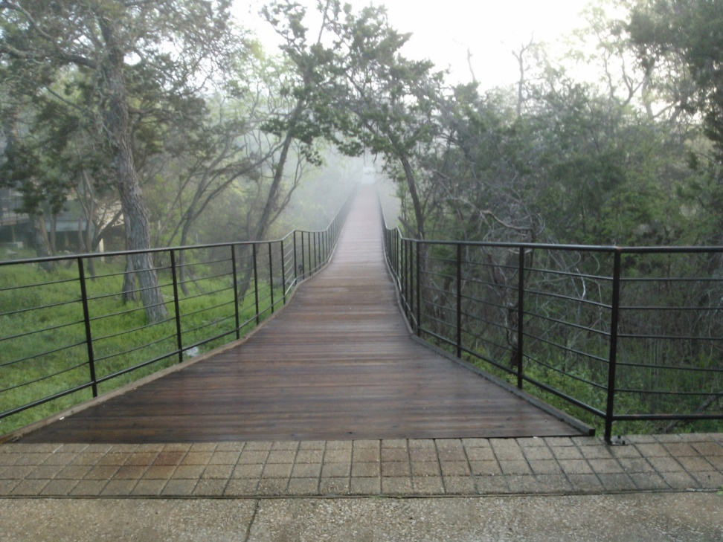
Discovery & The IL Framework
Using a “disruptive” technology to explore the frames of Information Literacy
TLU’s Engaging Pedagogy Conference
Ms. Mikail McIntosh-Doty, MA, MLIS, MAR
May 2017

Slide 2
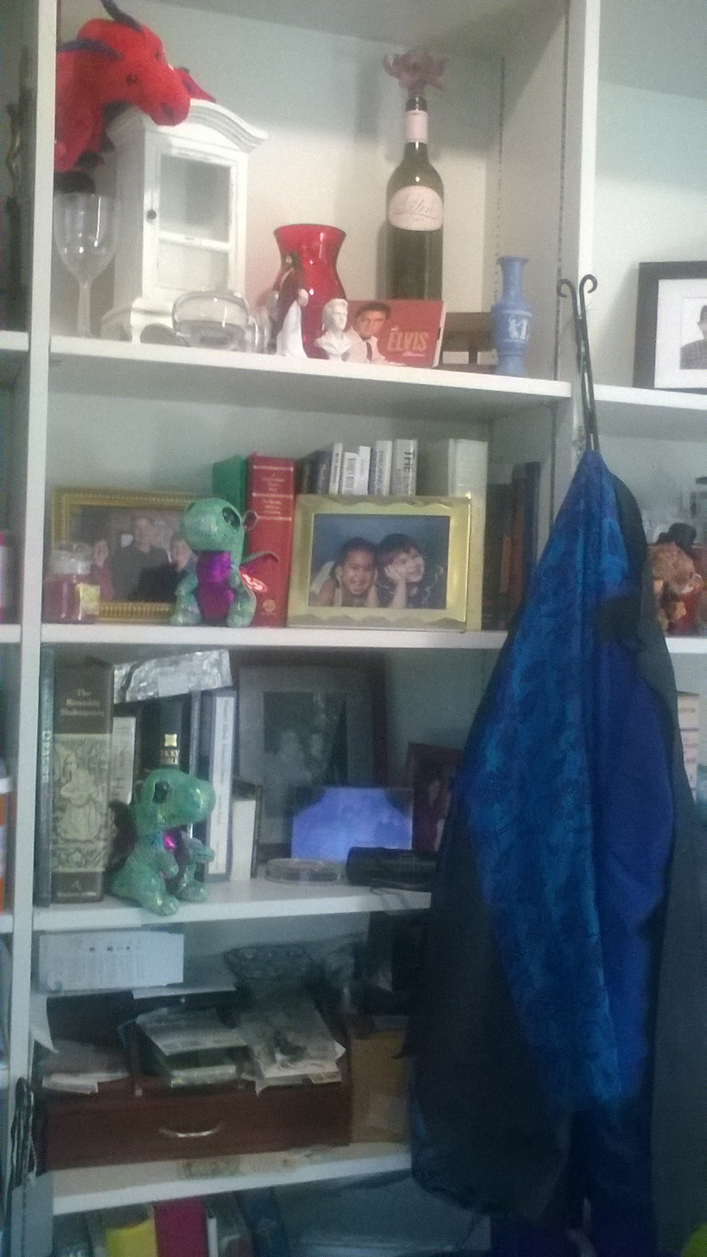
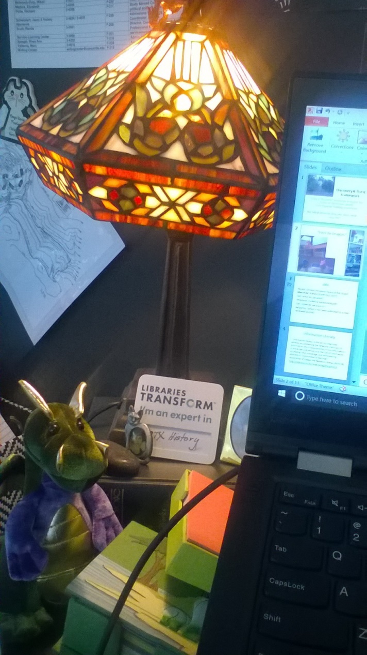
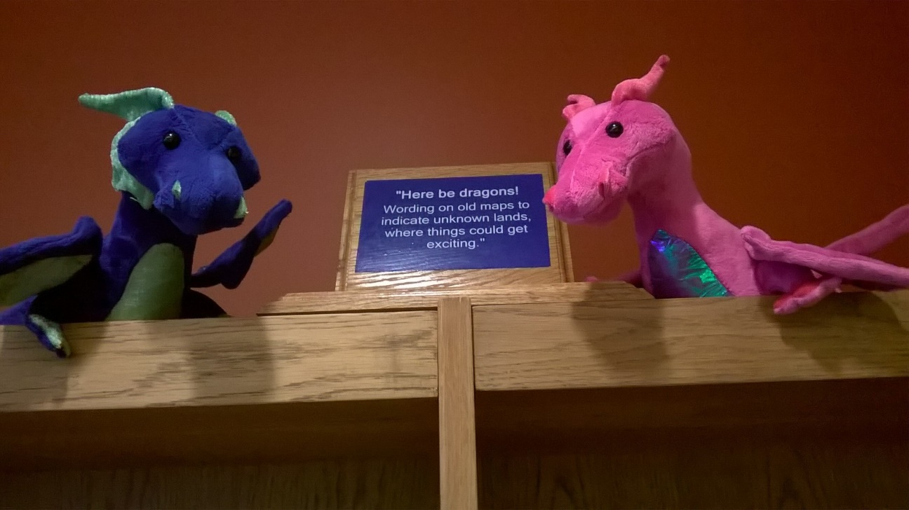
“Here Be Dragons” Library motto

Slide 3
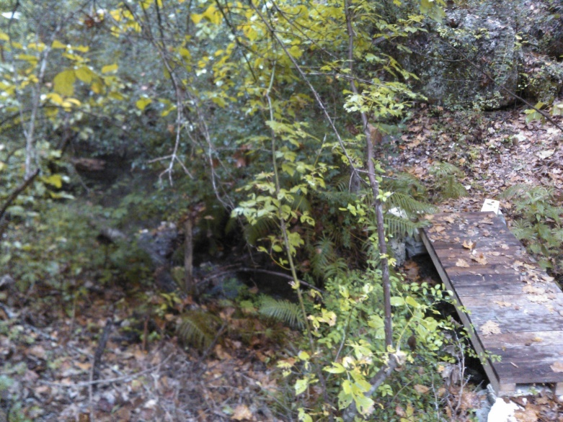
Joke
Answer/Response heard at the recent
March for Science (Earth Day 2017):
Call: What do we want?
Response: Evidence-based Research!
Call: When do we want it?
Response: When it has been published in a Peer-reviewed journal!

Slide 4
Information Literacy
“Information literacy is the set of integrated abilities encompassing the reflective discovery of information, the understanding of how information is produced and valued, and the use of information in creating new knowledge and participating ethically in communities of learning.”
Association of College and Research Libraries (2015/16)
http://www.ala.org/acrl/standards/ilframework

Slide 5
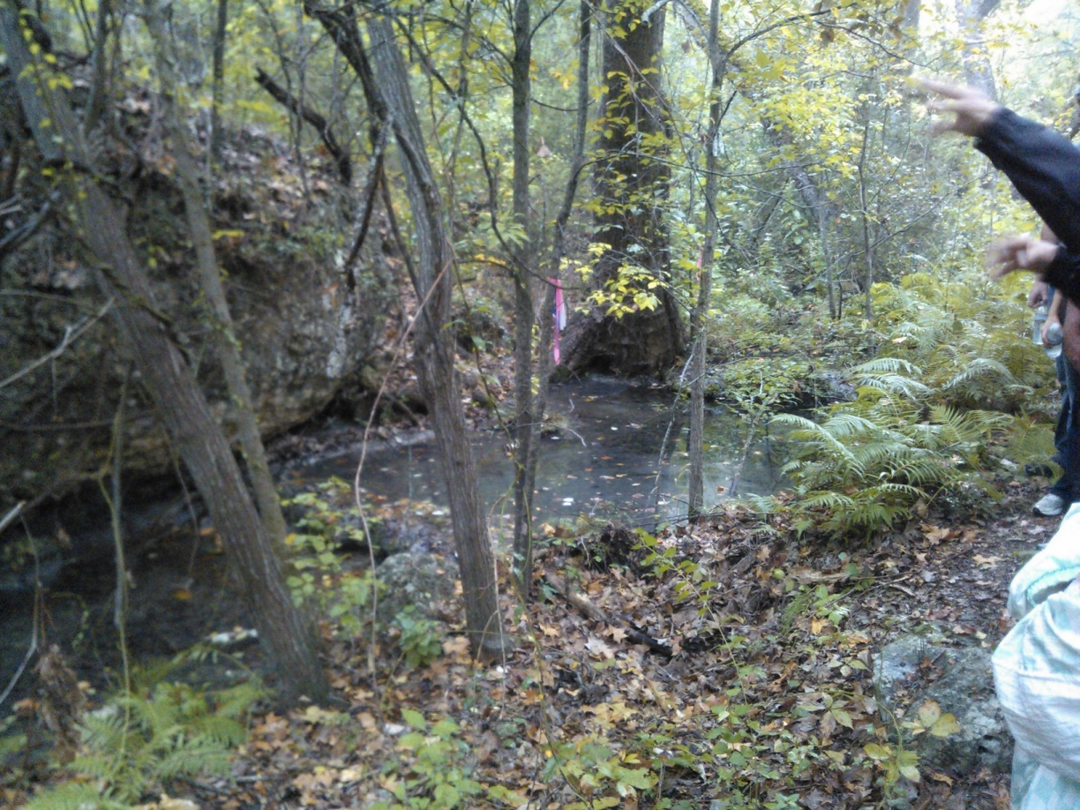
Information Literacy Frames
Authority Is Constructed and Contextual
Information Creation is a Process
Information Has Value
Research is Inquiry
Scholarship is Conversation
Searching is Strategic Exploration
ACRL (2015/16):
http://www.ala.org/acrl/standards/ilframework

Slide 6
What do those frames - phrases mean?
Please use the sheets around the room to add your own comments/phrases/observations on what each frame is trying to address.
[5 minutes]

Slide 7
Information Literacy Frames
Authority Is Constructed and Contextual
Information Creation is a Process
Information Has Value
Research is Inquiry
Scholarship is Conversation
Searching is Strategic Exploration
ACRL (2015/16):
http://www.ala.org/acrl/standards/ilframework

Slide 8
Discovery
Web-scale discovery is a concept not easily defined. As late as 2013, there were a couple of definitions floating about:
“an access tool”
Daniels et al. (2013) & Welch (2012)
“a concept” that provides a “solution” creating a most “intuitive whole”
Leebaw et al. (2013)

Slide 9
Discovery (or Web-scale discovery) Tools
EBSCO’s Discovery Search (EDS)
ProQuest’s Summon
Ex Libris’ Primo
WorldShare’s WorldCat Local
We’ll look at the first two.

Slide 10
EDS
The ultimate goal is to provide end users with a web-scale discovery service offering the best-possible research experience across several key search dimensions:
Availability of quality content
Content comprehensiveness
Quality of retrieved content
Site usability, functionality and performance
https://www.ebscohost.com/discovery/technology

Slide 11
Summon
The Summon® Service increases the value of your library by delivering an unprecedented research experience. More than a single-search box, the service makes your collection more discoverable and provides unique ways for users to connect with librarians in order to provide a rich research experience that
Presents results without bias,
increases resource usage
strengthens the library’s role in the research process
meets user expectations.
http://www.proquest.com/products-services/The-Summon-Service.html

Slide 12
How can you use discovery to explore the IL frames?
Features:
Searching
Limiters/Restrictors/Discipline Searches
Results List
Metadata – especially EDS
Keyword – especially Summons (and Google Scholar)
Algorithms
Citations
Boolean Searching
Altmetrics
Internal links – author, subject, etc.
Emailing option; file option
Etc. ……….?

Slide 13
Add Discovery Tools to the Frames
[Take five (5) minutes to add specific discovery tools to the IL frames on the walls]

Slide 14
How can you use discovery to explore the IL frames?
Features:
Searching
Limiters/Restrictors/Discipline Searches
Results List
Metadata – especially EDS
Keyword – especially Summons (and Google Scholar)
Algorithms
Citations
Boolean Searching
Altmetrics
Internal links – author, subject, etc.
Emailing option; file option
Etc. ……….?

Slide 15
Discovery searching as “disruptive technology”
A disruptive innovation
creates a new market and value network
eventually disrupts an existing market and value network
displaces established market leading firms, products and alliances.
Coined by Clayton M. Christensen, Harvard Business School, in 1995.
Disruptive innovation - Wikipedia
https://en.wikipedia.org/wiki/Disruptive_innovation

Slide 16
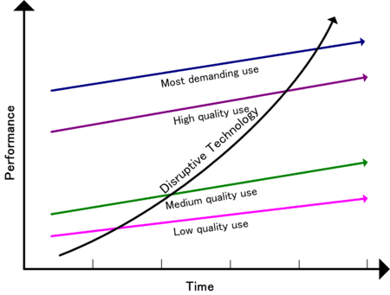
Chart of a disruptive technology

Slide 17
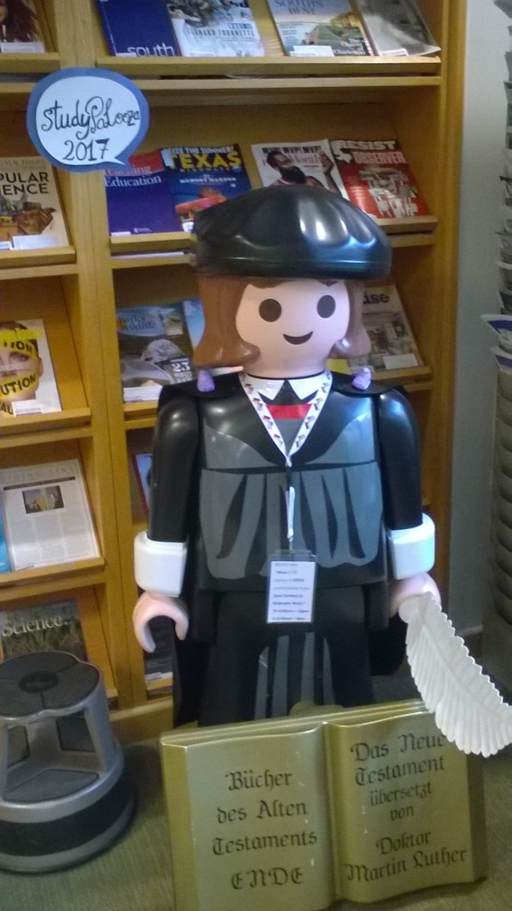
What are some disruptive technologies you know about?
Telephone
Iphone
Iwatch
Moveable Type
Typewriter
Computer
Cameras
Photocopiers
Scanners

Slide 18
How is discovery a disruptive technology?
Discuss.

Slide 19
How can you use the disruptive technology of discovery to help students engage the Information Literacy Framework?
Discuss. ☺

Slide 20
References
Berkman, R. (2016). ACRL's new Information Literacy Framework: Why now and what did ACRL discover? Online Searcher, (2), 46.
Daniels, J., Robinson, L., & Wishnetsky, S. (2013). Results of web-scale discovery: Data, discussions, and decisions. The Serials Librarian, 64(1–4), 81–87.
Kelley, M. (2012). Coming into focus: Web-scale discovery services face growing need for best practices. Library Journal, 137(17), 34.
Leebaw, D., Conlan, B., Gonnerman, K., Johnston, S., & Sinkler-Miller, C. (2013). Improving library resource discovery: Exploring the possibilities of VuFind and Web-scale discovery. Journal of Web Librarianship, 7(2), 154–189.
Welch, A. J. (2012). Implementing library discovery: A balancing act. In M. P. Popp & D. Dallis (Eds.),
Planning and implementing resource discovery tools in academic libraries (pp. 322–337). Hershey, PA: Information Science Reference.
Various websites as noted on slides.

Slide 21
Conclusions …
Here I stand (finished) and may the Peeps be with You!

