Slide 1
Incorporating Kahoot! Game Shows into Classes
Michael Czuchry & Tim Kent
Texas Lutheran University
Presentation at the Engaging Pedagogy Conference, May 2017
Texas Lutheran University, Seguin, Texas

Slide 2
Background
Research has shown that retrieval practice or the testing effect can lead to improved retention of material (Glover, 1989; McDaniel, Anderson, Derbish, & Morrisette, 2007; Roediger & Karpicke, 2006a; Roediger & Karpicke, 2006b).
Retrieval practice may especially benefit retention compared to a wide range of other techniques including knowledge mapping (Karpicke, & Blunt, 2011).
The generational effect has also been shown to improve retention (Hirshman & Bjork, 1988; Slamecka & Graf, 1978).
Research has shown mixed results for non-tested information, sometimes revealing suppression of this information (Anderson, Bjork, & Bjork, 1994) and sometimes facilitation (Chan, 2010).

Slide 3
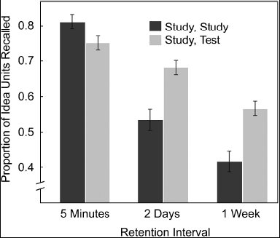
Testing itself can improve retention…
Free Recall
(No feedback)
(From Roediger & Karpicke, 2006)

Slide 4
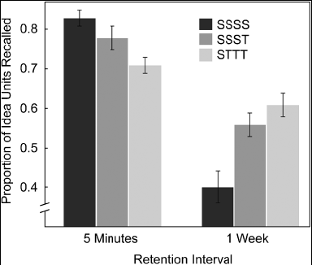
(From Roediger & Karpicke, 2006)
Free recall testing with no feedback increased retention 1 week later
Participants who reread materials were more confident they would remember
information one week later, but remembered the least

Slide 5
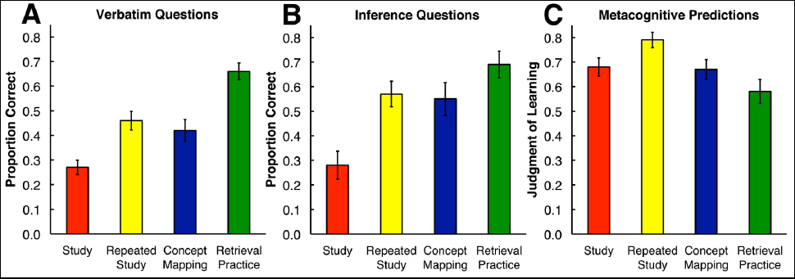
Retrieval practice appears to be particularly important…
From Karpicke & Blunt, 2011
Actual Memory (Panels A & B) and Predicted Performance (Panel C)
Engaging in free recall, compared to study, repeated study ,or concept mapping,
improved memory one week later for both verbatim and inference questions, but
students were wrong about their prediction for how they would do.
Stresses the importance of retrieval practice over encoding

Slide 6
Our Prior Work on Games in the Classroom
Examining the potential benefits of testing through game shows, and of generation through creation of questions, revealed that generation was particularly beneficial to students with lower expected performance (Kent & Czuchry, 2011).

Slide 7
Figure 1. Mean Percent Correct For Midterm Exam Scores Blocked By Student Ability And Generate Questions (Kent & Czuchry, 2011).
100
95.83
88.72
92.36
90
80
83.59
72.66*
70
Generate
Questions
Percent Correct
60
62.50*
50
No
Yes
40
30
20
10
0
Low
Medium
High
Expected Student Performance Based on Standardized SAT/ACT Scores
Note: * p < .05.

Slide 8
Our Prior Work on Games in the Classroom
Also found that testing information in a game show led to increased recall compared to information not tested in a game show (Kent & Czuchry, 2011).

Slide 9
Figure 2. Mean Percent Correct For Test Scores Blocked By Whether Or Not Question Was Present in Game Show (Kent & Czuchry, 2011).
77.96*
50.45*
Percent Correct
No
Yes
Question Present in Game Show
Note: * p < .05.

Slide 10
Current Study
Examined the potential benefits of integrating Kahoot! game shows and generating questions in two classes, PSYC 334: Cognitive Neuroscience and KINS 238: Foundations of Athletic Training

Slide 11
Primary Research Design: 2 X 2 X 2 ANOVAs
Class
KINS 238:
Foundations of
Athletic Training
PSYC 334:
Cognitive Neuroscience
No
N = 9
N = 14
Generate Questions
Yes
N = 9
N = 16
Dependent Variables
1) Percentage scores on exam targeting content present in Games
2) Percentage scores on exam targeting content not present in Games

Slide 12
Procedures
Students played their first Kahoot! Game prior to the first exam.
Students were randomly assigned to create (or to not create) 10 questions for the Kahoot! game prior to the second exam.
Items on the second exam targeted information present or not present in Kahoot! game shows.
Students then switched such that students who had not generated questions, now generated 10 questions for the Kahoot! game for the third exam.
Items on third exam targeted information present or not present in Kahoot! game shows.
Analyses used standardized scores from the first exam as a covariate.

Slide 13
Results: Second Exam
A 2X2X2 ANCOVA was conducted with Generate Questions (No vs. Yes) and Class (Cognitive Neuroscience vs. Foundations of Athletic Training) as between groups independent variables, and with items targeted in the game show and items not targeted as repeated dependent variables. Standardized scores from the first exam was used as a covariate.

Slide 14
Results: Second Exam
Significant effect for Question Type, F(1,43) = 10.33, p < .05, η²_{p} = .194. (See Figure 3).
Significant effect for Generate Questions, F(1,43) = 5.130, p < .05, η²_{p} = .107. (See Figure 4).
Significant interaction between Generate Questions and Question Type, F(1,43) = 4.48, p < .05, η²_{p} = .094. (See Figure 5).
Significant effect for Class, F(1,43) = 27.60, p < .05, η²_{p} = .391. (See Figure 6).
Significant effect for the covariate, F(1,43) = 32.37, p < .05, η²_{p} = .429.

Slide 15
Figure 3. Means and Standard Errors for Percent Correct on the Second Exam
for Material Covered or Not Covered in Kahoot! Game Shows.
Percent Correct
Note. Means are statistically corrected for scores on the first exam.

Slide 16
Figure 4. Means and Standard Errors for Percent Correct on the Second Exam
for Students Generating or Not Generating Questions.
Percent Correct
Note. Means are statistically corrected for scores on the first exam.

Slide 17
Figure 5. Means and Standard Errors for Percent Correct on the Second Exam
for Material Covered or Not Covered in Kahoot! Game Shows.
Percent Correct
Note. Means are statistically corrected for scores on the first exam.

Slide 18
Figure 6. Means and Standard Errors for Percent Correct on the Second Exam
in PSYC 334 and KINS 238.
Percent Correct
Note. Means are statistically corrected for scores on the first exam.

Slide 19
Results: Third Exam
A 2X2X2 ANCOVA was conducted with Generate Questions (No vs. Yes) and Class (Cognitive Neuroscience vs. Foundations of Athletic Training) as between groups independent variables, and with items targeted in the game show and items not targeted as repeated dependent variables. Standardized scores from the first exam was used as a covariate.

Slide 20
Results: Third Exam
Significant effect for Question Type, F(1,43) = 24.89, p < .05, η²_{p} = .367. (See Figure 7).
Significant interaction between Class and Question Type, F(1,43) = 20.79, p < .05, η²_{p} = .326. (See Figure 8).
Significant effect for Class, F(1,43) = 26.34, p < .05, η²_{p} = .380. (See Figure 9).
Significant effect for the covariate, F(1,43) = 35.26, p < .05, η²_{p} = .451.

Slide 21
Figure 7. Means and Standard Errors for Percent Correct on the Third Exam
for Material Covered or Not Covered in Kahoot! Game Shows.
Percent Correct
Note. Means are statistically corrected for scores on the first exam.

Slide 22
Figure 8. Means and Standard Errors for Percent Correct on the Third Exam
for Material Covered or Not Covered in Kahoot! Game Shows.
*
Percent Correct
Note. Means are statistically corrected for scores on the first exam.

Slide 23
Figure 9. Means and Standard Errors for Percent Correct on the Third Exam
in PSYC 334 and KINS 238.
Percent Correct
Note. Means are statistically corrected for scores on the first exam.

Slide 24
Conclusion
Although not the focus of today’s presentation, students enjoy the inclusion of Kahoot! games in the classroom.
The games also lead to significant improvements on exams.
Some evidence that generating questions also facilitates recall of information not directly tested in Kahoot! games.
It is likely that the benefits observed in this study cut across a wide range of game types and formats.
Future research should examine whether there is a dose related effect of question generation, whether essay questions facilitate retention better than multiple choice questions, and whether Kahoot! also facilitates retention under different testing formats.

Slide 25
References
Anderson, M. C., Bjork, R. A., & Bjork, E. L. (1994). Remembering can cause forgetting: Retrieval dynamics in long-term memory. Journal of Experimental Psychology: Learning, Memory, and Cognition, 20(5), 1063-1087.
Chan, J. K. (2010). Long-term effects of testing on the recall of nontested materials. Memory, 18(1), 49-57.
Glover, J. A. (1989). The “testing” phenomenon: Not gone but nearly forgotten. Journal of Educational Psychology, 81, 392-399.
Hirshman, E., & Bjork, R. A. (1988). The generation effect: Support for a two-factor theory. Journal of Experimental Psychology: Learning, Memory, and Cognition, 14(3), 484-494.
Karpicke, J. D., & Blunt, J. R. (2011). Retrieval practice produces more learning than elaborate studying with concept mapping. Science, 331(6018), 772-775.
McDaniel, M. A., Anderson, J. L., Derbish, M. H., & Morrisette, N. (2007). Testing the testing effect in the classroom. European Journal of Cognitive Psychology, 19(4-5), 494-513.
Roediger, H., & Karpicke, J. D. (2006a). Test-Enhanced Learning: Taking Memory Tests Improves Long-Term Retention. Psychological Science, 17(3), 249-255.
Roediger, H., & Karpicke, J. D. (2006b). The power of testing memory: Basic research and implications for educational practice. Perspectives on Psychological Science, 1(3), 181-210.
Slamecka, N. J., & Graf, P. (1978). The generation effect: Delineation of a phenomenon. Journal of Experimental Psychology: Human Learning and Memory, 4(6), 592-604.

Slide 26
Contact Information
Michael Czuchry, mczuchry@tlu.edu
Tim Kent, tkent@tlu.edu

