Slide 1
Giving Students More Effective Feedback Using Electronic Mechanisms
Calvin Berggren
Texas Lutheran University
Engaging Pedagogy Conference
17 May 2017

Slide 2
Advantages of Electronic Student Work
May allow for more immediate feedback
May allow for more effective feedback
Greatly simplifies collaboration
Provides a permanent record
Much easier to organize, search
No papers to carry around
May save paper
– but technology can be cumbersome

Slide 3
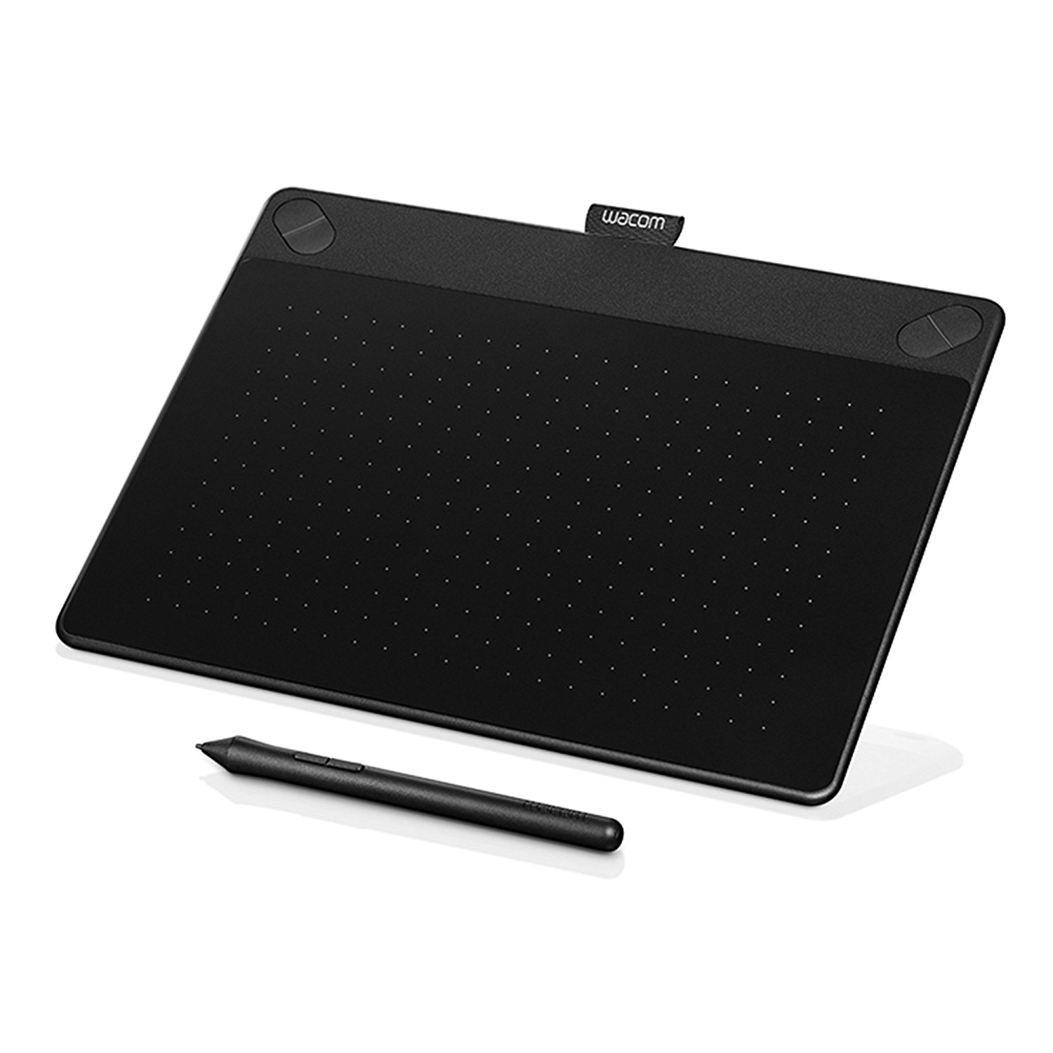
Hardware
Wacom Intuos Art Pen and Touch
Medium size
Digitizer tablet that provides pen (and touch) input to computer
Can be connected to any computer
$200

Slide 4
Typing or Inking in Word
Use standard comments and “Track Changes” in “Review” tab
Digitizer allows you to ink corrections and comments instead of typing them
Useful for:
Grading papers
Grading lab reports

Slide 5
Inking with Audio in PowerPoint
Scan exams to digitize, then export from PDF to PowerPoint
Use Office Mix add-in for PowerPoint
Allows inking and audio to be synchronized
Removes any thought of or reference to video editing
Video is also possible
Video-like media viewed by students on web
Useful for:
Grading exams

Slide 6
Grading in Student’s Presence
I have staggered homework turn-in times to allow 5-15 minute block per student
I grade their assignment in front of them
There is no easier way to provide effective feedback
Useful for:
Grading assignments

Slide 7
Inking Live in PowerPoint
Digitizer can be used to ink slides live during lecture
Useful for:
Lecture

Slide 8
Cloud-based Collaboration through OneDrive
Connected to TLU account on Office 365 – www.office365.com
Tightly linked with MS Office
Full fidelity
Full power of desktop office applications
Browser-based option
Allows real-time collaboration
Removes need to pass files back and forth
Physics department uses:
Senior seminar
Reports for advanced labs

