Slide 1
Integrating Computation into STEM Curriculum
Calvin Berggren
Texas Lutheran University
Engaging Pedagogy Conference
17 May 2017

Slide 2
Physics
“The American Association of Physics Teachers urges that every physics and astronomy department provide its majors and potential majors with appropriate instruction in computational physics.”
“almost all undergraduate students who take physics courses will use computational tools in their future careers even if they do not become practicing physicists.”
AAPT Statement on Computational Physics
“a curriculum in which computation is absent or plays a minor role is inauthentic to the contemporary discipline.”
Wolfgang Christian and Bradley Ambrose, “An Introduction to the Theme Double-Issue”, Am. J. Phys. 76 (4&5), 293-294 (2008).

Slide 3
Math
“An excellent mathematics program integrates the use of mathematical tools and technology as essential resources to help students learn and make sense of mathematical ideas, reason mathematically, and communicate their mathematical thinking”
NCTM and AMTE statements
“The importance of maths to jobs, society and thinking has exploded over the last few decades. Meanwhile, maths education is … diverging more and more from computational thinking–based problem-solving required by countries, industry, further education… and students”
computerbasedmath.org
Notes:
NCTM - National Council of Teachers of Mathematics
AMTE - Association of Mathematics Teacher Educators

Slide 4
Physics
Theoretical
Experimental

Slide 5
Physics
Theoretical
Experimental
Computational

Slide 6
Math
computerbasedmath.org

Slide 7
Math
computerbasedmath.org

Slide 8
Skills
Fundamental computer skills
operating systems
file systems
coding
using computational tools
Technical computing skills
process data
visualize data
Computational skills
translate models or algorithms into code
write/test/debug code
divide problem into manageable computational tasks
make meaning of results

Slide 9
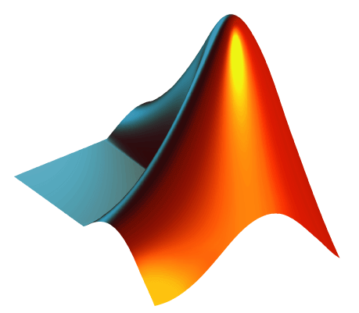
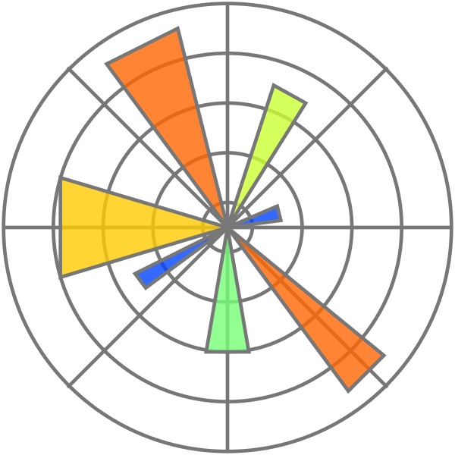
General-purpose programming languages
Excel
Mathematica
Maple
MATLAB
Integrated Mathematical Computing Packages
Python
C++
Packages
SciPy
Jupyter
Spreadsheets
Matplotlib

Slide 10
Rationale
“Physics degree programs should reflect the contemporary practice of physics — and computation is now ubiquitous in that practice.”
“Students gain a deeper understanding of physics”
“Students using computation can develop a more exploratory approach to studying physical systems”
“Students using computation can solve a much wider range of problems”
“Students using computation can develop critical skills and knowledge necessary for doing fundamental and applied research, better preparing them for a wide variety of careers.”
AAPT UCTF Computational Physics Report (online)

Slide 11
Comprehensive update to the physics major
Adding computation to the physics major
Revamp PHYS/MATH 371
Integrate computation into labs
Computational concentration
Bolster supporting coursework in CSCI
Supplement introductory and advanced courses
Revamp PHYS 390-391

Slide 12
Revamp PHYS 390
PHYS 390: Applied Computational Physics I
Emphasis on computational modeling
Emphasis on using computational techniques to solve physical systems, especially differential equations
Emphasis on designing, writing, and analyzing algorithms
Emphasis on computational topics important for physics
Notes:
One goal is comfort with computational approach to solving physical problems

Slide 13
Revamp PHYS 391
PHYS 391: Applied Computational Physics II
Project-based course, some in teams
Emphasis on practical experience with tools and skills used in industry
Data analysis, data processing
3D modeling, 3D printing
Physical computing and microcontrollers
Control systems
Emphasis on presentation of results

Slide 14
Supplementing other courses
Development of computational skills should be integrated into the curriculum, rather than taught as isolated skills.
Working with data
Visualizing data
Automated data collection
Symbolic calculations
Large numerical calculations
Notes:
First bullet point from AAPT UCTF Comp. Physics Report

Slide 15
Example – Freshman Physics II
Topic: Solving for current throughout a large multi-branch circuit
Problem: Resulting system of equations is computationally intensive in all but the simplest and least interesting circuits
Computational skills:
Translate Kirchhoff’s laws into matrix form amenable to computation
Leverage linear algebra package to solve
Computational tools:
Python – NumPy

Slide 16
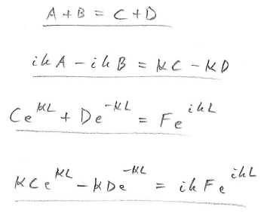
Example – Quantum Mechanics
Topic: Solving Schrödinger equation for a potential barrier
Problem: System of equations is very algebraically intensive
Computational skills:
Leverage computer algebra system to solve
Computational tools:
Python – SymPy
Mathematica
Maple

Slide 17
Example – PHYS/MATH 371
Topics: derivatives, integrals, eigensystems, Fourier series/transforms, power series, Laurent series, residues
Problem: All of these can quickly become intensive by hand, and computers are used in real world
Goal: Achieve parity between conceptual, work-by-hand, and work-by-computer
Computational skills:
Computational modeling
Making meaning of results
Computational tools:
Python – SymPy

Slide 18
Challenges
Every tool, language, package, etc. you use at all requires overhead
Standardize on tools
Adding new material to curriculum
Augment existing topics where it makes sense
Be strategic
Coding is hard and students have variety of backgrounds
Scaffolding
Lack of textbook support

Slide 19
Math
computerbasedmath.org

Slide 20
Math
computerbasedmath.org

