Slide 1
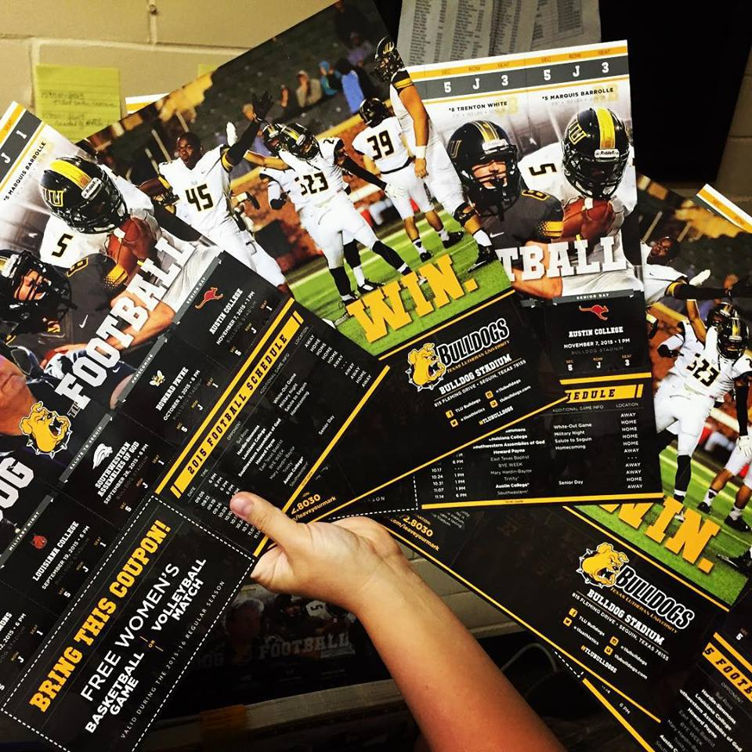
Time to Huddle Up: Keeping Football Players in College
Sean A. Bogle Jr.
Emily M. Braun
Hannah L. Spears
Tiffiny L. Sia PhD
Texas Lutheran University
Notes:
Need Affiliation
Title needs to be larger
Authors need middle initials

Slide 2
Universities need better football player Retention
Universities are ranked nationally based on graduate rates (Sobel 2013).
Institutions need high retention for tuition to maintain high quality academics and athletics (Sobel 2013).
Football players represent a significant amount of the Universities student body (Lang 1988).
The football team needs retention to have senior players for a deeper bench (more depth) (Williams 2010).
Notes:
Need to all be same font size (try 24)

Slide 3
Introduction to Division 3 Football
Research shows despite the number of Division 3 athletes, this group receives little attention in comparison to Division 1 and 2 athletes (Robst & Keil 2000).
Research also reveals that student athletes at a Division 3 university have lower GPAs than non-athletes (Robst & Keil 2000).
Many players are dependent on academic scholarships and show inconsistent retention without them (Wolverton &Newman 2013).
The current study looks at various academic and athletic characteristics that may be associated with first year retention patterns for football players.

Slide 4
Lifetime Impacts on the Players
Students with college degrees earn more than those with just a high school diploma (Burnsed, 2011).
Students who fail in college can still incur substantial debt (Gladieux & Perna, 2005).
Student athletes are accused of focusing more on academic eligibility than finishing their degree or college (Stuart 1985).

Slide 5
Method: Participants
Total N= 321 freshman football players from 2011-2015
Academic Preparedness (based on a median split of High School GPA)
Low Prepared Players= 149 (46%)
High Prepared Players= 145 (45%)
Major on Enrollment
Decided= 182 (56%) Undecided= 139 (43%)
Player Status
Active (Traveling)= 63 (53.8%)
Inactive (Practice Squad)= 36 (30.7%)
Former Players (Quit but remained at TLU)= 18 (15.3%)
Notes:
Add ‘TLU’ in front of football players

Slide 6
How the information was gathered
Academic Information from Institutional Research
Ethnicity, High School GPA, Initial Academic Major, Term Hours Attempted, Yearly Enrollment, First Generation Status, and Religion
Football Information from TLU football program
Players Initial and Yearly Status (Active or Practice Squad), Championship Winning Seasons, Position, Distance from Home, and Players’ High School
Notes:
Be consi
***to say outloud
The FERPA regulations guarantee the privacy of student’s data.
Researchers had no access to individual’s names or identifying information
Calculations:
Distance from home to Seguin based on miles on the road.
A median split on High School GPA separated players into higher (HPA) and lower (LPA) GPA.
A median split on High School Football playoff appearances for the last 8 years separated players into successful high school and unsuccessful high school.
***Add a visual for football purposes

Slide 7
Players Freshman Demographics
Table 1. | Active Players | Practice Squad | Former Players | Total
Overall (n) | 166 (51.7%) | 137 (42.7%) | 18 (5.6%) | 321
White | 82 (51.25%) | 66 (41.25%) | 12 (7.5%) | 160
Non-White | 84 (52.17%) | 71 (44.11%) | 6 (3.72%) | 161
Academic Statistics
Stayed at the University | 63 (53.8%) | 36 (30.7%) | 18 (15.3%) | 117
Left the University | 103 (50.4%) | 101 (49.5%) | N/A | 204
Higher HS GPA (>2.98) | 70 (46.9%) | 67 (44.9%) | 12 (8%) | 149
Lower HS GPA (<2.98) | 77 (53.1%) | 64 (44.1%) | 4 (2.7%) | 145
Major Decided | 96 (52.7%) | 76 (41.7%) | 10 (5.4%) | 182
Major Undecided | 70 (50.3%) | 61 (43.8%) | 8 (5.7%) | 139
(>15) Term Hours Attempted | 49 (59%) | 25 (30%) | 9 (10.8%) | 83*
(<15) Term Hours Attempted | 117 (49%) | 112 (47%) | 9 (3.78%) | 238*
Athletic Statistics
Entered in Championship Year | 86 (43.2%) | 103 (51.7%) | 10 (5%) | 199
Entered in non-Championship Year | 80 (65.5%) | 34 (27.8%) | 8 (6.5%) | 122
Distance from home (>150 miles) | 87 (55%) | 67 (41.1%) | 9 (5.5%) | 163
Distance from home (<150 miles) | 79 (50%) | 70 (44.3%) | 9 (5.6%) | 158
First Generation | 61 (45.1%) | 70 (51.8%) | 4 (2.3%) | 135
Notes:
Give more room on right side
Make the bottom portion a darker gray

Slide 8
Goals of the Study
A TLU Summer Research Grant provided funding to analyze existing data on football player retention.
The goal was to come up with a retention plan the met three criteria:
No additional cost to the University
The Faculty and Student Life would support the plan
The football coaches and players will support the plan

Slide 9
Regression predicting Retention
Step Wise Regression revealed one significant fall to spring predictor:
Major: F(1, 210) =152.224; p<.05, $n^{2}$=.412
Step-Wise Regression showed four significant fall to fall predictors:
Major: F(1, 210) = 156.176; p<.05, $n^{2}$=.426
Initial Player Status: F(2, 209) = 88.448; p<.05, $n^{2}$=.314
High School GPA: F(4, 207)= 51.711; p<.05, $n^{2}$=.499
TLU Football Success: F(3,208)= 64.788; p<.05, $n^{2}$= .483
Two, 2x2x2 ANOVAs were run with Academic Major (Decided vs Undecided), Initial Player Status (Active vs Practice Squad), Academic Preparedness (median split of High School GPA (HPA vs LPA) as independent variables (IV’s).
Notes:
Eta SQUARED (add the 2)
Add p values
Italicize F and p

Slide 10
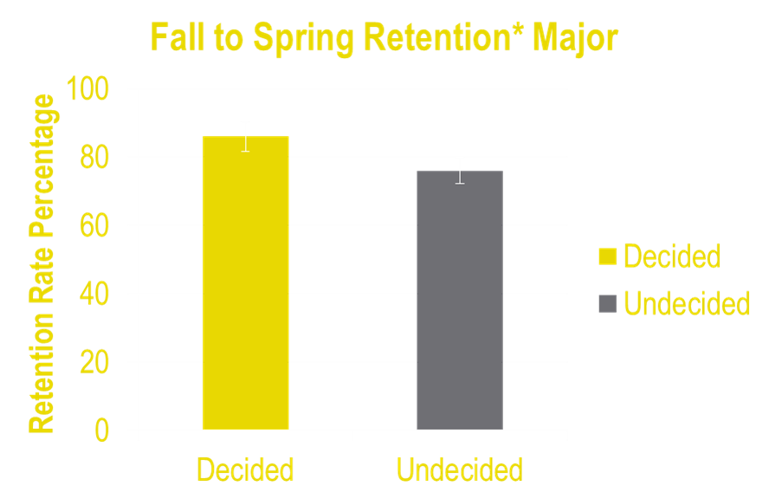
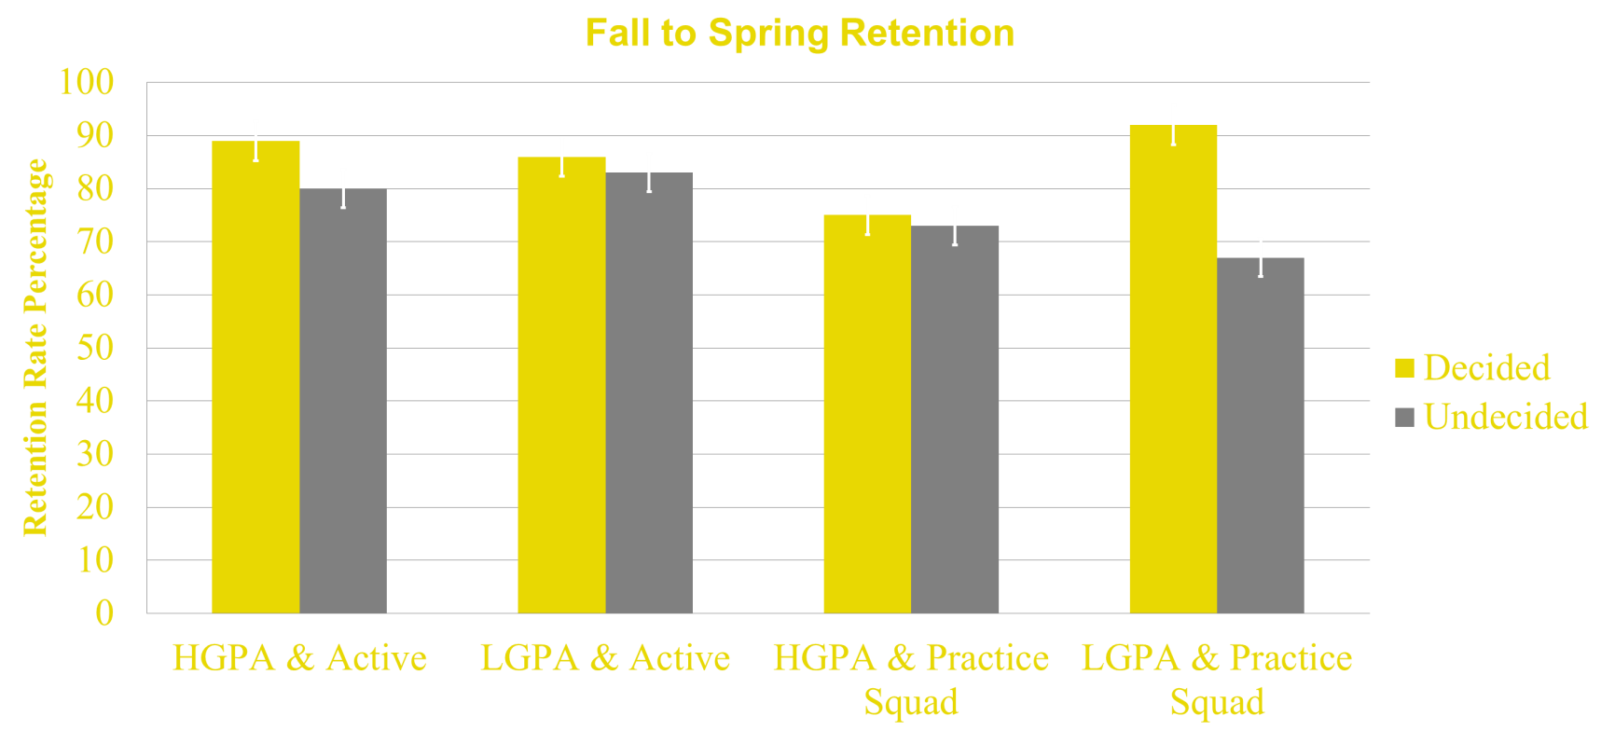
Freshman Fall to spring retention
Players with a decided Major had a higher fall to spring retention rate (86%) than the undecided players (76%), F(1, 286)= 4.45, p<.05, $n^{2}$=.01.
Figure 1.
There were no other significant effects (Academic Preparedness, p=.560; Initial Player Status, p=.09; Interaction, p=.12).
Notes:
Make error bars thicker and make font bigger (24); f and p italicized, label y axis, title above graph
If they don’t play they don’t stay means nothing
Add a black box to cover the light at the bottom

Slide 11
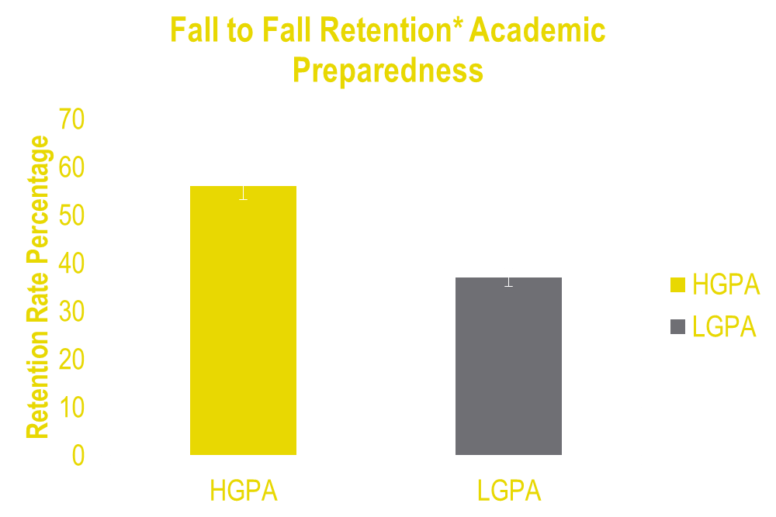
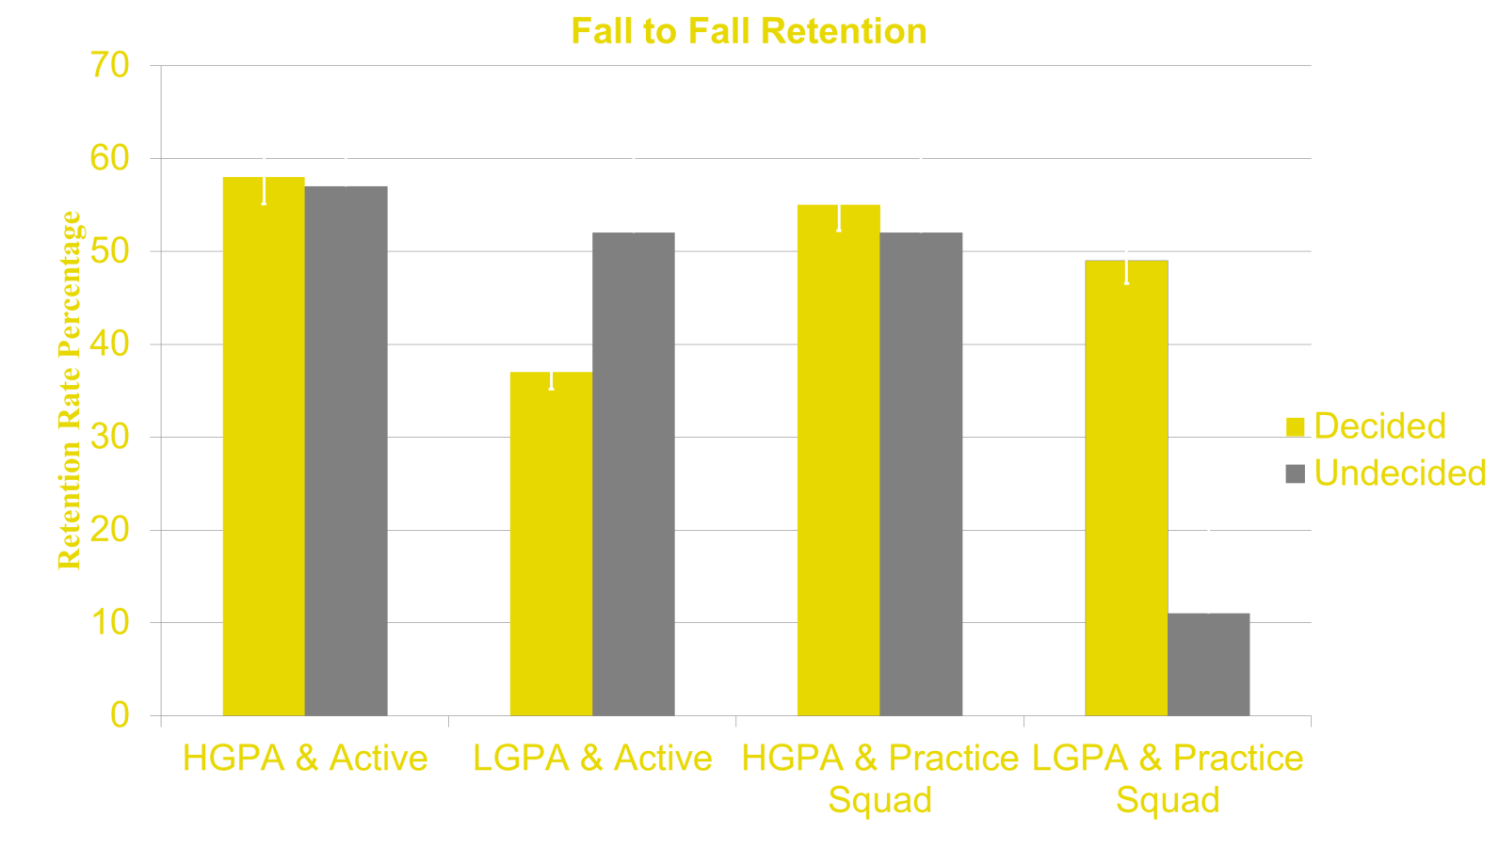
Freshman Fall to Fall retention
Players who were above the median split for a good HS GPA, had a higher retention rate (56%) than those players who were below the median split for a good HS GPA (37%). F(1, 211)=7.041, p>.05, $n^{2}$ =.03.
There were no other significant effects (Major, p=.342; Initial Player Status, p=.175; Interaction, p=.068).
Figure 2.
Notes:
Fix legend- decided/undecided???
Interaction between Major, Initial playing status, Academic Preparedness

Slide 12
Freshman football players cant take a full load?
A 2x3 ANOVA with initial term hours (15 plus vs. below 15) and ending playing status (practice squad vs. active players vs. former players) as IV’s and Fall to Spring retention as DV was run.
There was a significant main effect for ending playing status, such that Practice Squad (73%) retained significantly less than the active squad (83%) and former players (100%) F(2, 315)= 3.934, p<.05, ɳ=.02.
There were no other significant main effect for initial term hours with respect to Fall to Spring retention.
Figure 3.
Notes:
Pull info from 1 page handout

Slide 13
The Plan (to be instituted fall of 2017)
Step 1: Try out a Major
Make incoming freshman choose a preliminary major during player check in.
Like any player, they can change majors.
This may keep them here for the second semester.
Step 2: Study Hall to Win
Math and Writing CLA’s are next door to football’s mandatory study hall.
Specialized peer mentor assistance during mandatory study hall for players at risk (below a 2.9 GPA).
Training in making up assignments before missing the class with peer mentors or senior players.
Step 3: 15 to Finish
Make the incoming freshman players sign up for 15 course hours.
Coaches have talking points on lifelong impact of taking 15 hours.
Coaches will recommend dropping a class if the player is reported as academically struggling.
Notes:
Add bullet point about raising gpa of concern to 2.9 from 2.5
3 point plan

Slide 14
References
Burnsed, Brian. (2011). How Higher Education Affects Lifetime Salary. U.S. News Education.
Gladieux, L., & Perna, L. (2005). Borrowers Who Drop Out: A Neglected Aspect of the College Student Loan Trend. The National Center for Public Policy and Higher Education.
Lang, G., Dunham, R. G., & Alpert, G. P. (1988). Factors Related to the Academic Success and Failure of College Football Players. The Case of the Mental Dropout. Youth & Society, 20(2), 209.
Robst, J., & Keil J. (2000). The Relationship between Athletic participation and academic performance: Evidence from NCAA Division 3. Applied Economics, 32, 547-558.
Schneider, R., Ross, S., & Fisher, M. (2010). Academic clustering and Major selection of Intercollegiate Student Athletes. College Student Journal, 64-70.
Sobel, A. E. (2013). The Escalating Cost of College. Computer (00189162), 46(12), 85-87.
Stuart, Debra. (1985). Academic Preparation and Subsequent Performance of Intercollegiate Football Players. Journal of College Student Personnel, 124-129.
Williams, R. (2010, July 7). Using deep bench strength to develop talent. Retrieved March 07, 2017, from https://www.psychologytoday.com/blog/wired-success/201007/using-deep-bench- strength-develop-talent
Wolverton, B., & Newman, J. (2013, April 26). Few Athletes Benefit From Move to Multiyear Scholarships. Chronicle of Higher Education. pp. A3-A4.

Slide 15
Acknowledgments
I would like to thank…
The research team for spending hours going over data and building the talking points for change. Emily M. Braun & Hannah L. Spears.
The Professors of the TLU Psychology department for funding the grant which gave me the opportunity to run the study. Carolyn Turner, Scott Bailey, Michael Czuchry, & Tiffiny Sia.
The TLU Football Program for sharing player information, having faith in us, and collaborating in an effort to implement the findings. Danny Padron (Former Head Football Coach), Carl Gustafson (Head Football Coach), Kyle Ingram (Assistant Head Coach), & Bob Jonas (Athletic Liaison).
TLU’s Institutional Research for giving us the data and information needed to run the study. Jean Constable (Director) & James R. Gibson (Student Worker).
The Student Success Committee for pulling all of the departments together in order to increase awareness of the findings in the study to all appropriate TLU Faculty and Staff. Malikah Harvey (Assoc. Dean of Student Life and Learning), Lisa Cradit (Director of Academic Support), Debbie Cottrell (VP for Academic Affairs), & Bill Miller (Director of Athletics).

Slide 16
Questions?
For more information contact:
Sean A. Bogle Jr: sabogle@tlu.edu
Tiffiny L. Sia: tsia@tlu.edu
Notes:
As well as contact information

